Slide 1
MPXV genomic epidemiology & squirrel
Slide from Áine O’Toole
Notes:
But if we take a step back from this-

Slide 2
MPXV genomic epidemiology
Zoonotic spillover
Most cases historically in children <15
Sustained human transmission
Slide from Áine O’Toole
Notes:
Based on early studies in the DRC, most cases of mpxv were found to occur in children, mostly young boys

Slide 3
MPXV genomic epidemiology
Zoonotic spillover
Most cases historically in children <15
Secondary transmission rare
Sustained human transmission
1st in Nigeria, now DRC
Slide from Áine O’Toole
Notes:
More recently- seen outbreaks of sustained human transmission- first observed in Nigeria from 2017, now in the DRC

Slide 4
MPXV genomic epidemiology
Zoonotic spillover
Most cases historically in children <15
Secondary transmission rare
Sustained human transmission
1st in Nigeria, now DRC
Sexual transmission & high partner exchange contact networks
Ndodo, N., Ashcroft, J., Lewandowski, K. et al. Nat Med 29, 2317–2324 (2023).
Vakaniaki, E.H., Kacita, C., Kinganda-Lusamaki, E. et al. Nat Med (2024).
Slide from Áine O’Toole
Notes:
Appears that sexual transmission is a driver in both of these cases

Slide 5
Slide from Áine O’Toole
Notes:
Mpxv now has four clades- two major clades 1 and 2, and each of those are now broken into iia and iib
A subset of clade iib is the sustained human outbreak that was first detected in Nigeria in 2017

Slide 6
2017 Nigeria reported cases
Slide from Áine O’Toole
Notes:
A subset of clade iib is the sustained human outbreak that was first detected in Nigeria in 2017 and then went global in 2022

Slide 7
2017 Nigeria reported cases
Slide from Áine O’Toole
Notes:
For context- I want to briefly describe what we observe with regards to apobec3 mutations in the outbreak first reported in Nigeria in 2017. the Nigerian outbreak lies within clade iib

Slide 8
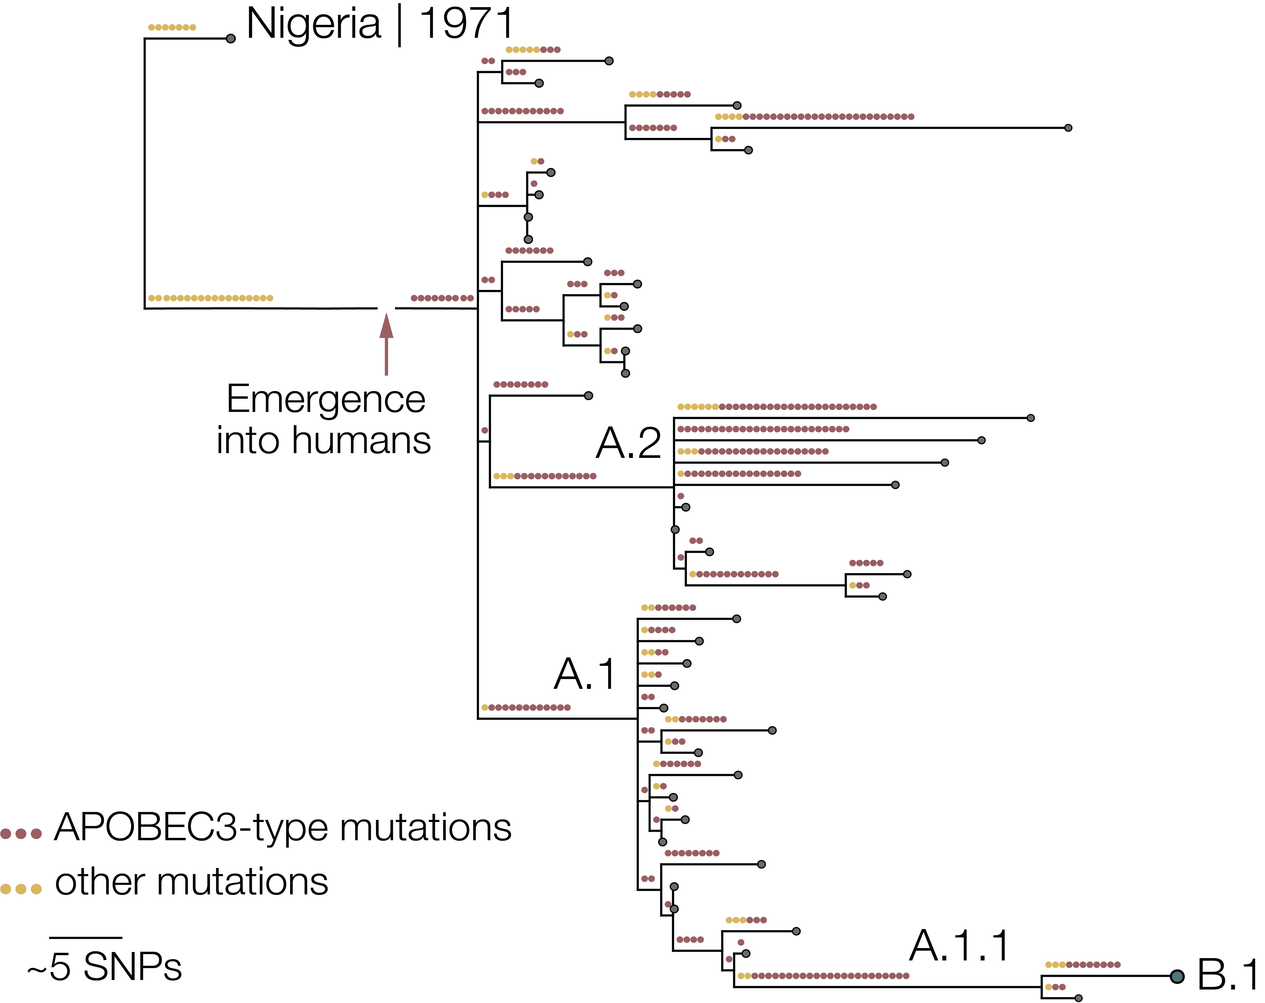
2017 Nigeria reported cases
Nigeria
2017-2018
Nigeria
2018-2019
2022
Slide from Áine O’Toole
USA | 2021
Notes:
And If we zoom in to clade iib
we can immediately see there is quite a lot of diversity here. The single sequence labelled b.1 is the major cluster that represents much of the diversity that has spread globally in 2022

Slide 9
dsDNA virus
Expect ~1 nucleotide change every 3 years
Nigeria
2017-2018
42 SNPs
Nigeria
2018-2019
2022
Isidro et al Nat. Med 2022
Gigante et al Science 2022
Slide from Áine O’Toole
USA | 2021
Notes:
And this is the big long branch of 42 snps links the 2022 sequences to the earlier cases in Nigeria. For a double stranded dna virus is a lot of mutations to have accumulated in just a few short years

Slide 10
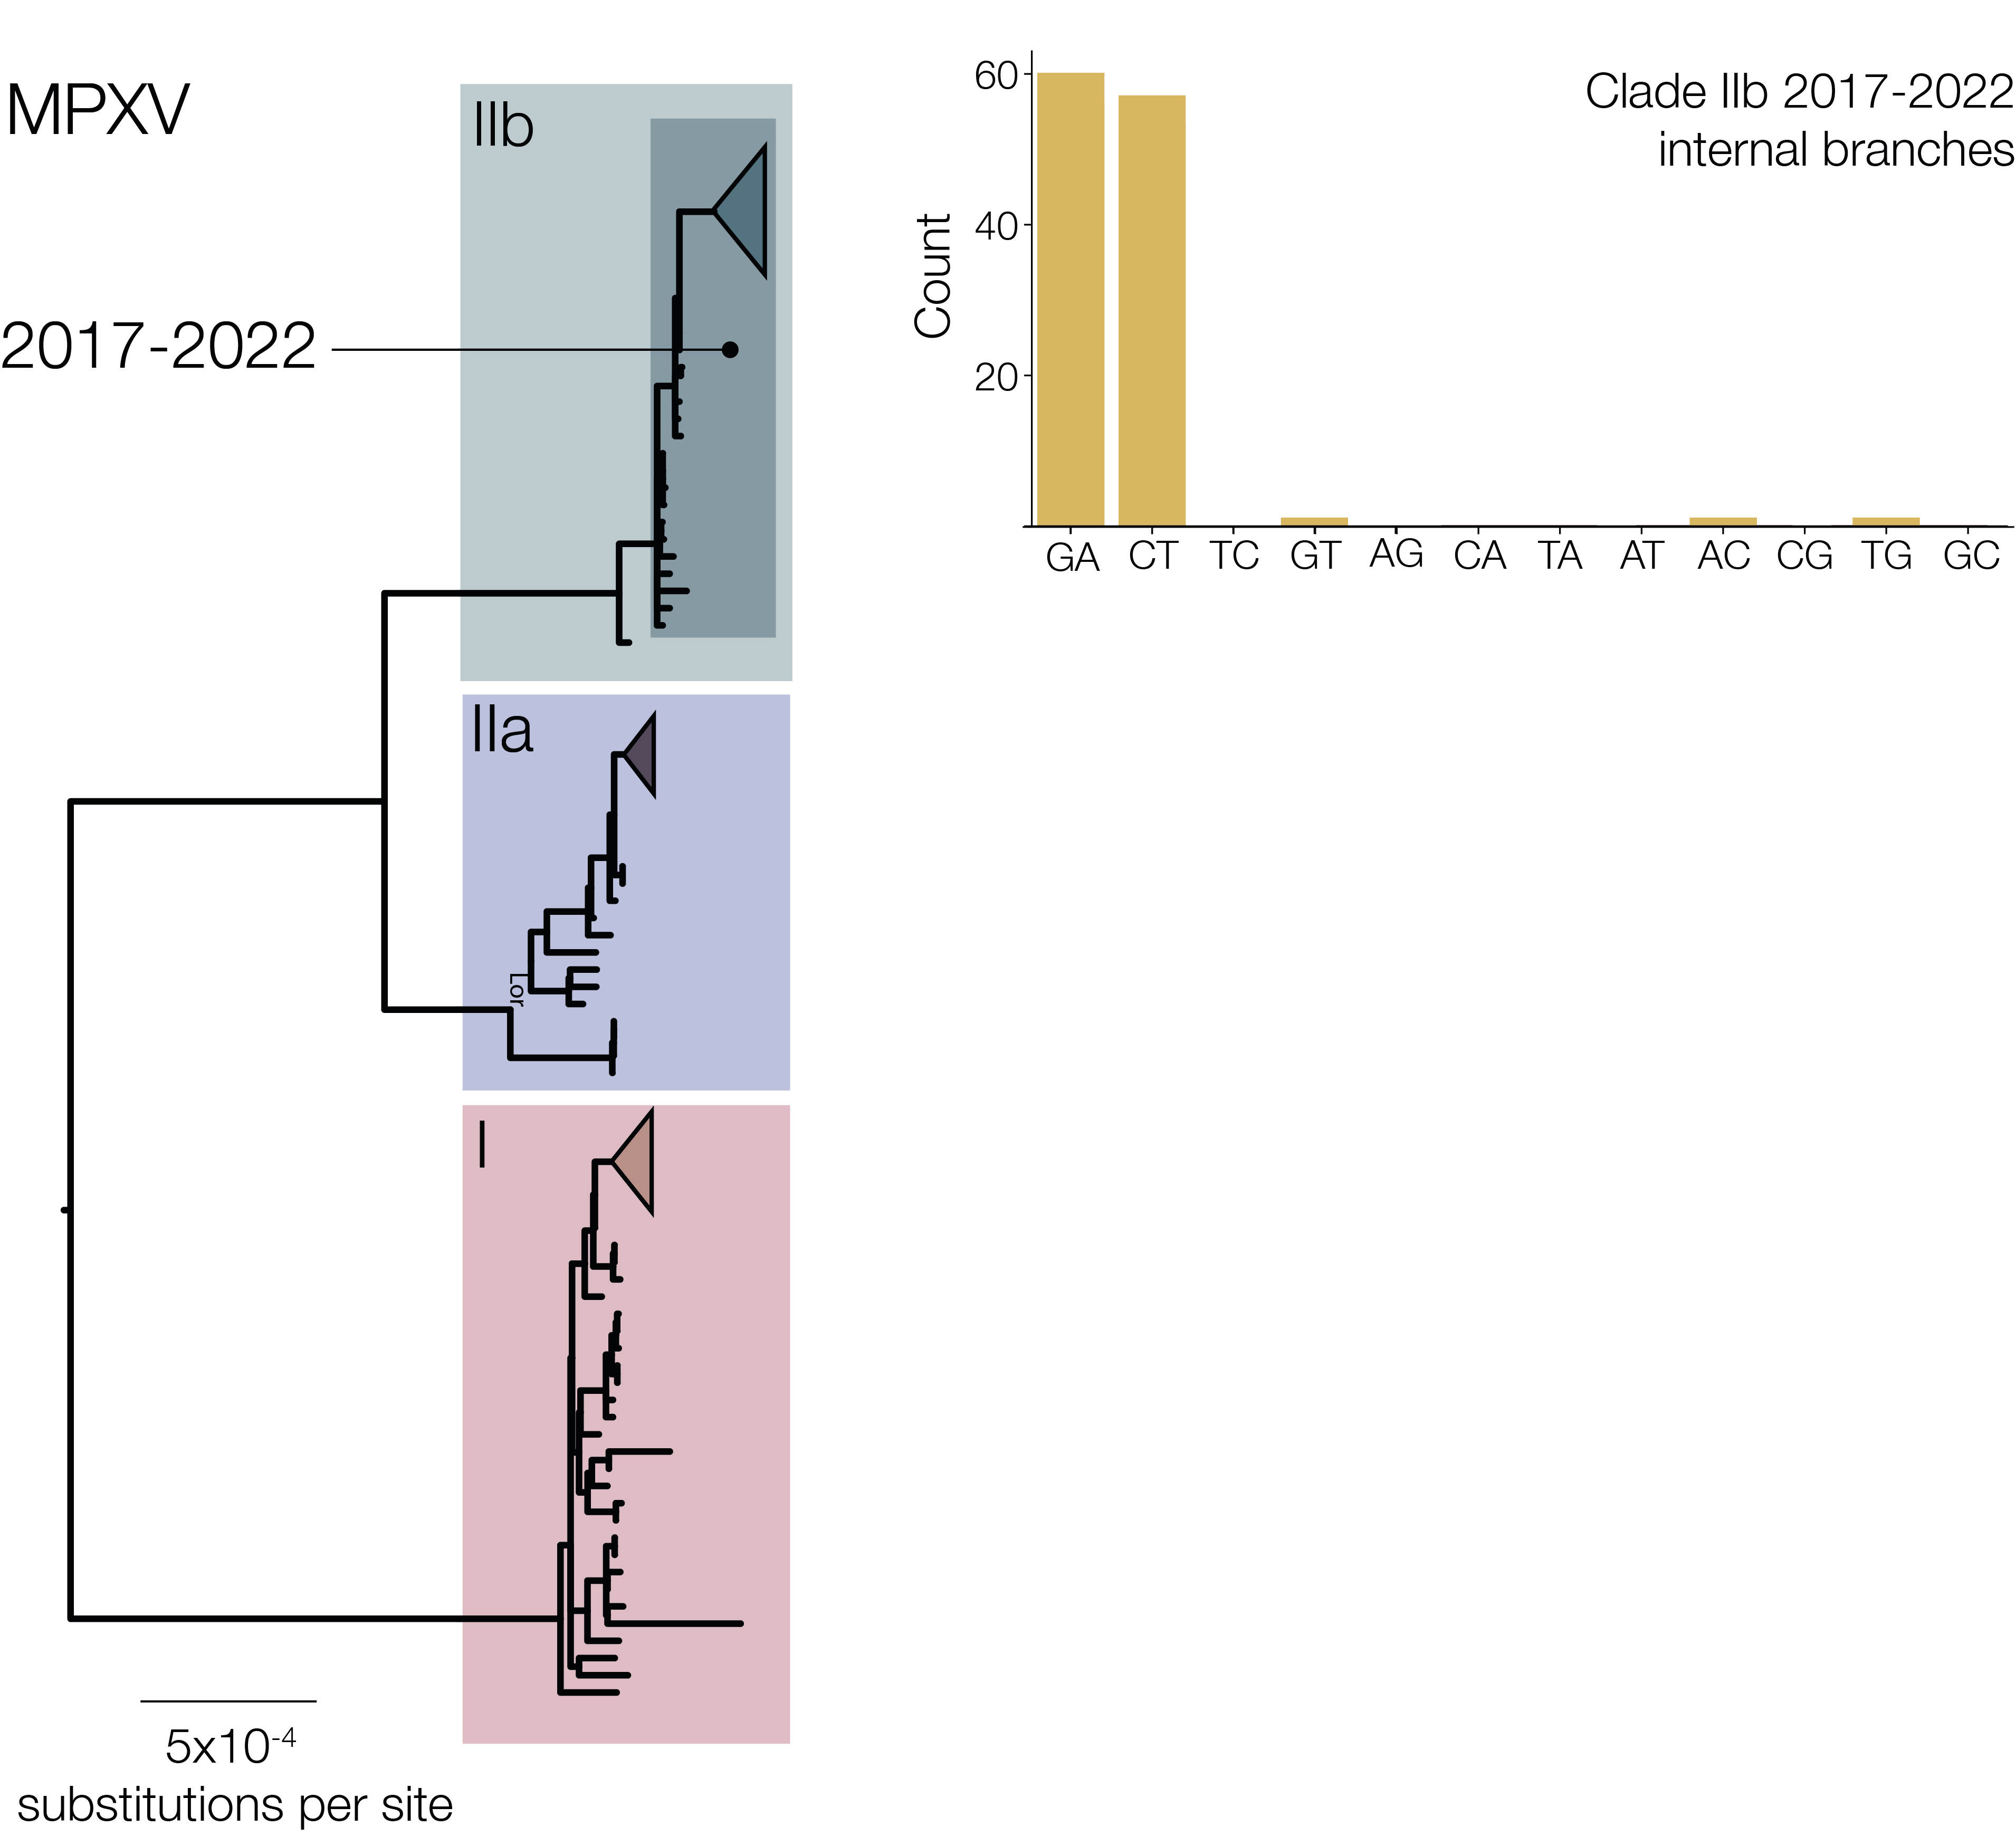
Slide from Áine O’Toole
Notes:
if we Look at the observed mutations that have occurred within clade iib since 2017 (this is not including the genomes from the 2022 B.1 lineage)

Slide 11
Mostly G→A and C→T mutations
Slide from Áine O’Toole
Notes:
we see they’re primarily G->A and C->T mutations
And this sort of extreme skew might suggest there could be some unusual evolutionary patten going on here

Slide 12
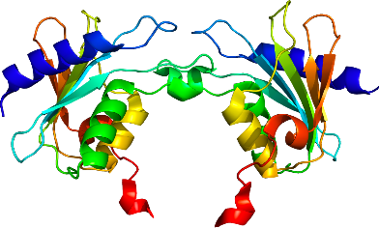
Mostly G→A and C→T mutations
Signature of APOBEC3 deamination
Slide from Áine O’Toole
Notes:
And we have seen- and in vitro studies have confirmed- that this is consistent with apobec3 deamination

Slide 13
APOBEC3
AGATCGTG
Observed mutation
AGATTGTG
Slide from Áine O’Toole
Notes:
APOBEC3 is a family of cytidine deaminases that has a preference for binding tc dinucleotides and converts them to tt

Slide 14
Slide from Áine O’Toole
Notes:
So If we go back to our snp plot for the current outbreak, where we see this enrichment of g to a and c to t mutations, and if we color them by whether they’re in the dinucleotide context that apobec3 prefers

Slide 15
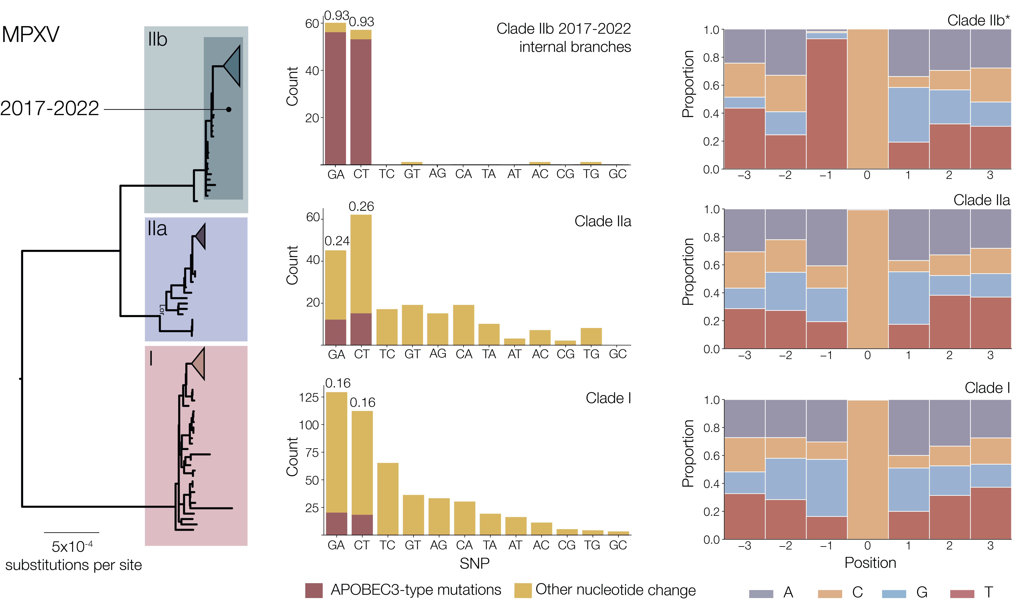
Slide from Áine O’Toole
Notes:
we see in red all the mutations that fit with apobec3 editing- there is specific enrichment of this dinucleotide context and clear signatures that are consistent with apobec3 editing.
On the right panel you can see the heptamer content around observed C->T and G->A mutations in this part of the phylogeny, normalised to the positive strand. So 0 position is the mutation observed, and then we look upstream and downstream of the site.

Slide 16
Slide from Áine O’Toole
Notes:
When we compare this to the other two mpox virus clades (clade I and iia, which haven’t been observed in the current outbreak), we do not see the same pattern

Slide 17
90.8%
13%
8%
Slide from Áine O’Toole
Notes:
If we put numbers on it- more than 90% of observed mutations within clade iib are consistent with abobec3 editing as opposed to 13 and 8 percent in the other clades

Slide 18
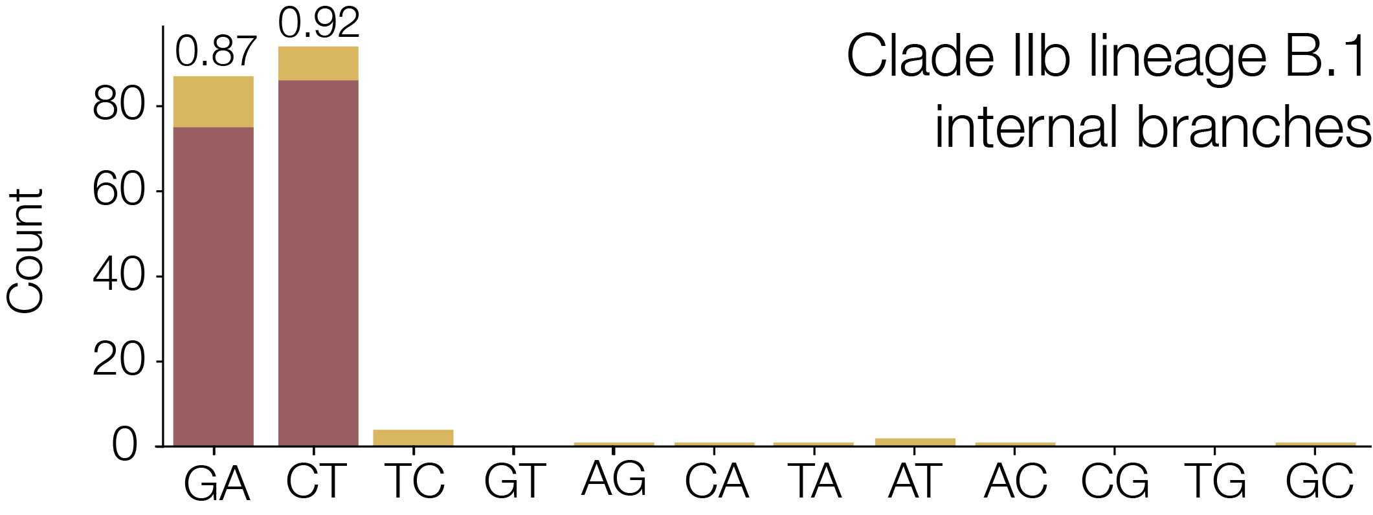
(known H2H)
Slide from Áine O’Toole
Notes:
And remember that this top panel doesn’t include B.1, which we know has been spread globally through human to human transmission,
if we look at the mutations that we observe within b.1, we see the same pattern of mutation consistent with apobec3 editing.

Slide 19
2023-4 DRC reported cases
Slide from Áine O’Toole
Notes:
If we go back to our overall phylogeny, we can look at the recent cases that have been reported and sequenced in the DRC

Slide 20

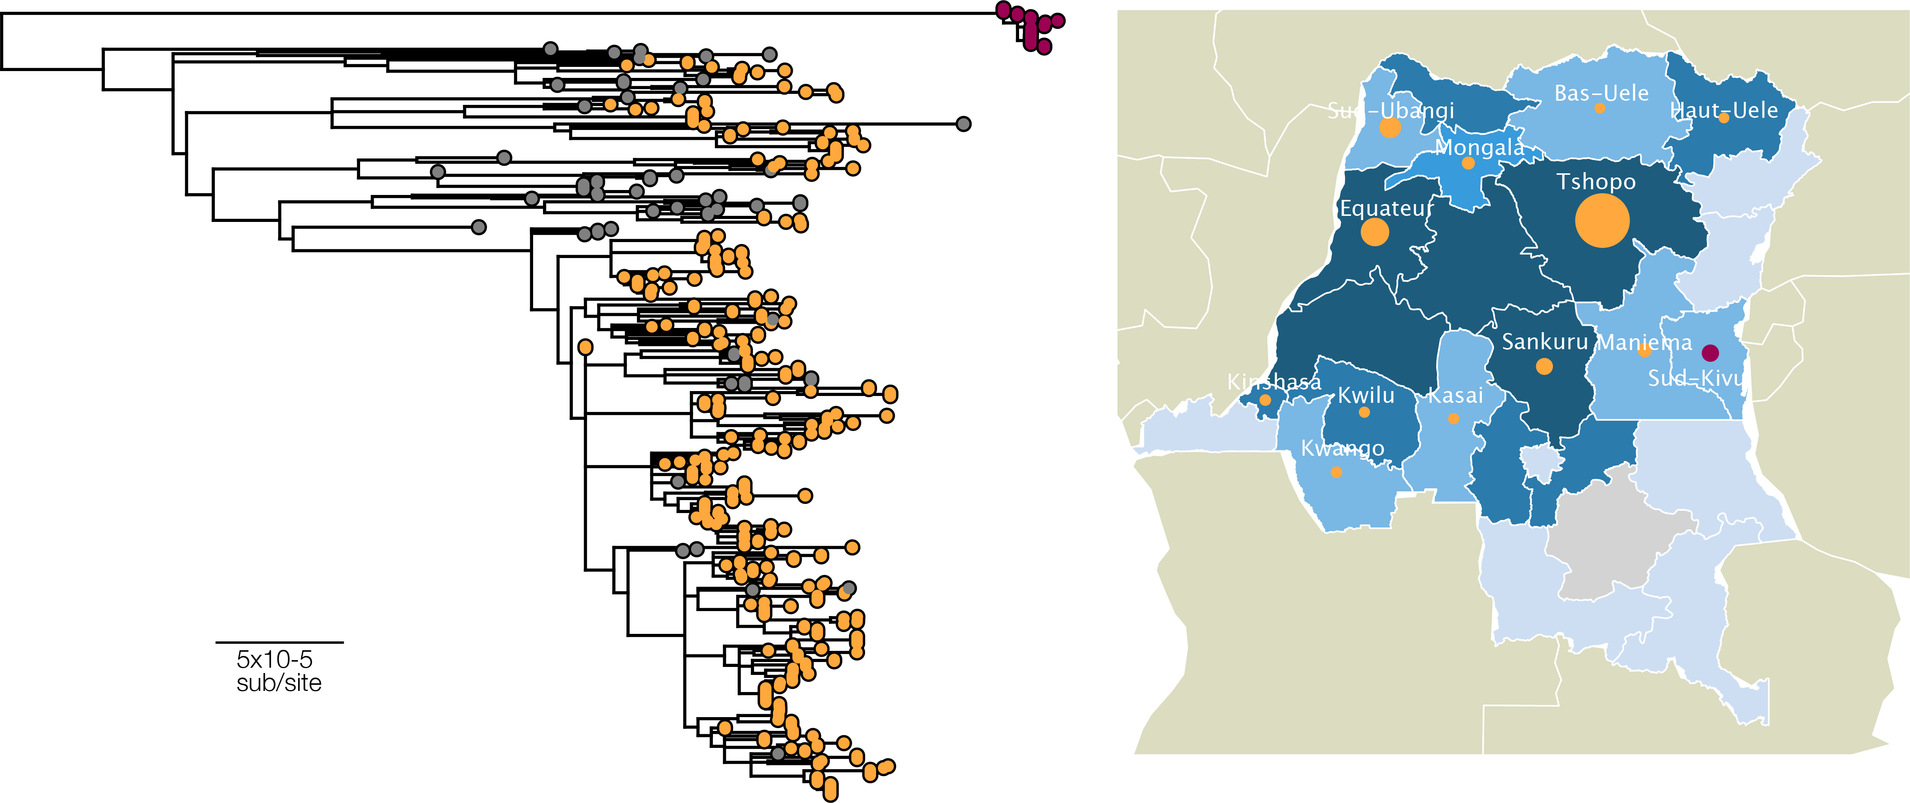
Placide Mbala
Eddy Lusamaki
Sud-Kivu
Other recent DRC
Background
Slide from Áine O’Toole
Notes:
we’ve been working closely with Placide and Eddy to investigate the recent cases

Slide 21
~360 MPXV genome sequences
Sud-Kivu
Other recent DRC
Background
Slide from Áine O’Toole
Notes:
This data shows two very different pictures- the south kivu cases are distinct from most of the reported cases
And as it happens demographics of cases in this area are different, with most cases in adults, and the majority of cases in women.
Epi investigations have linked these cases to sexual transmission and sex-work

Slide 22
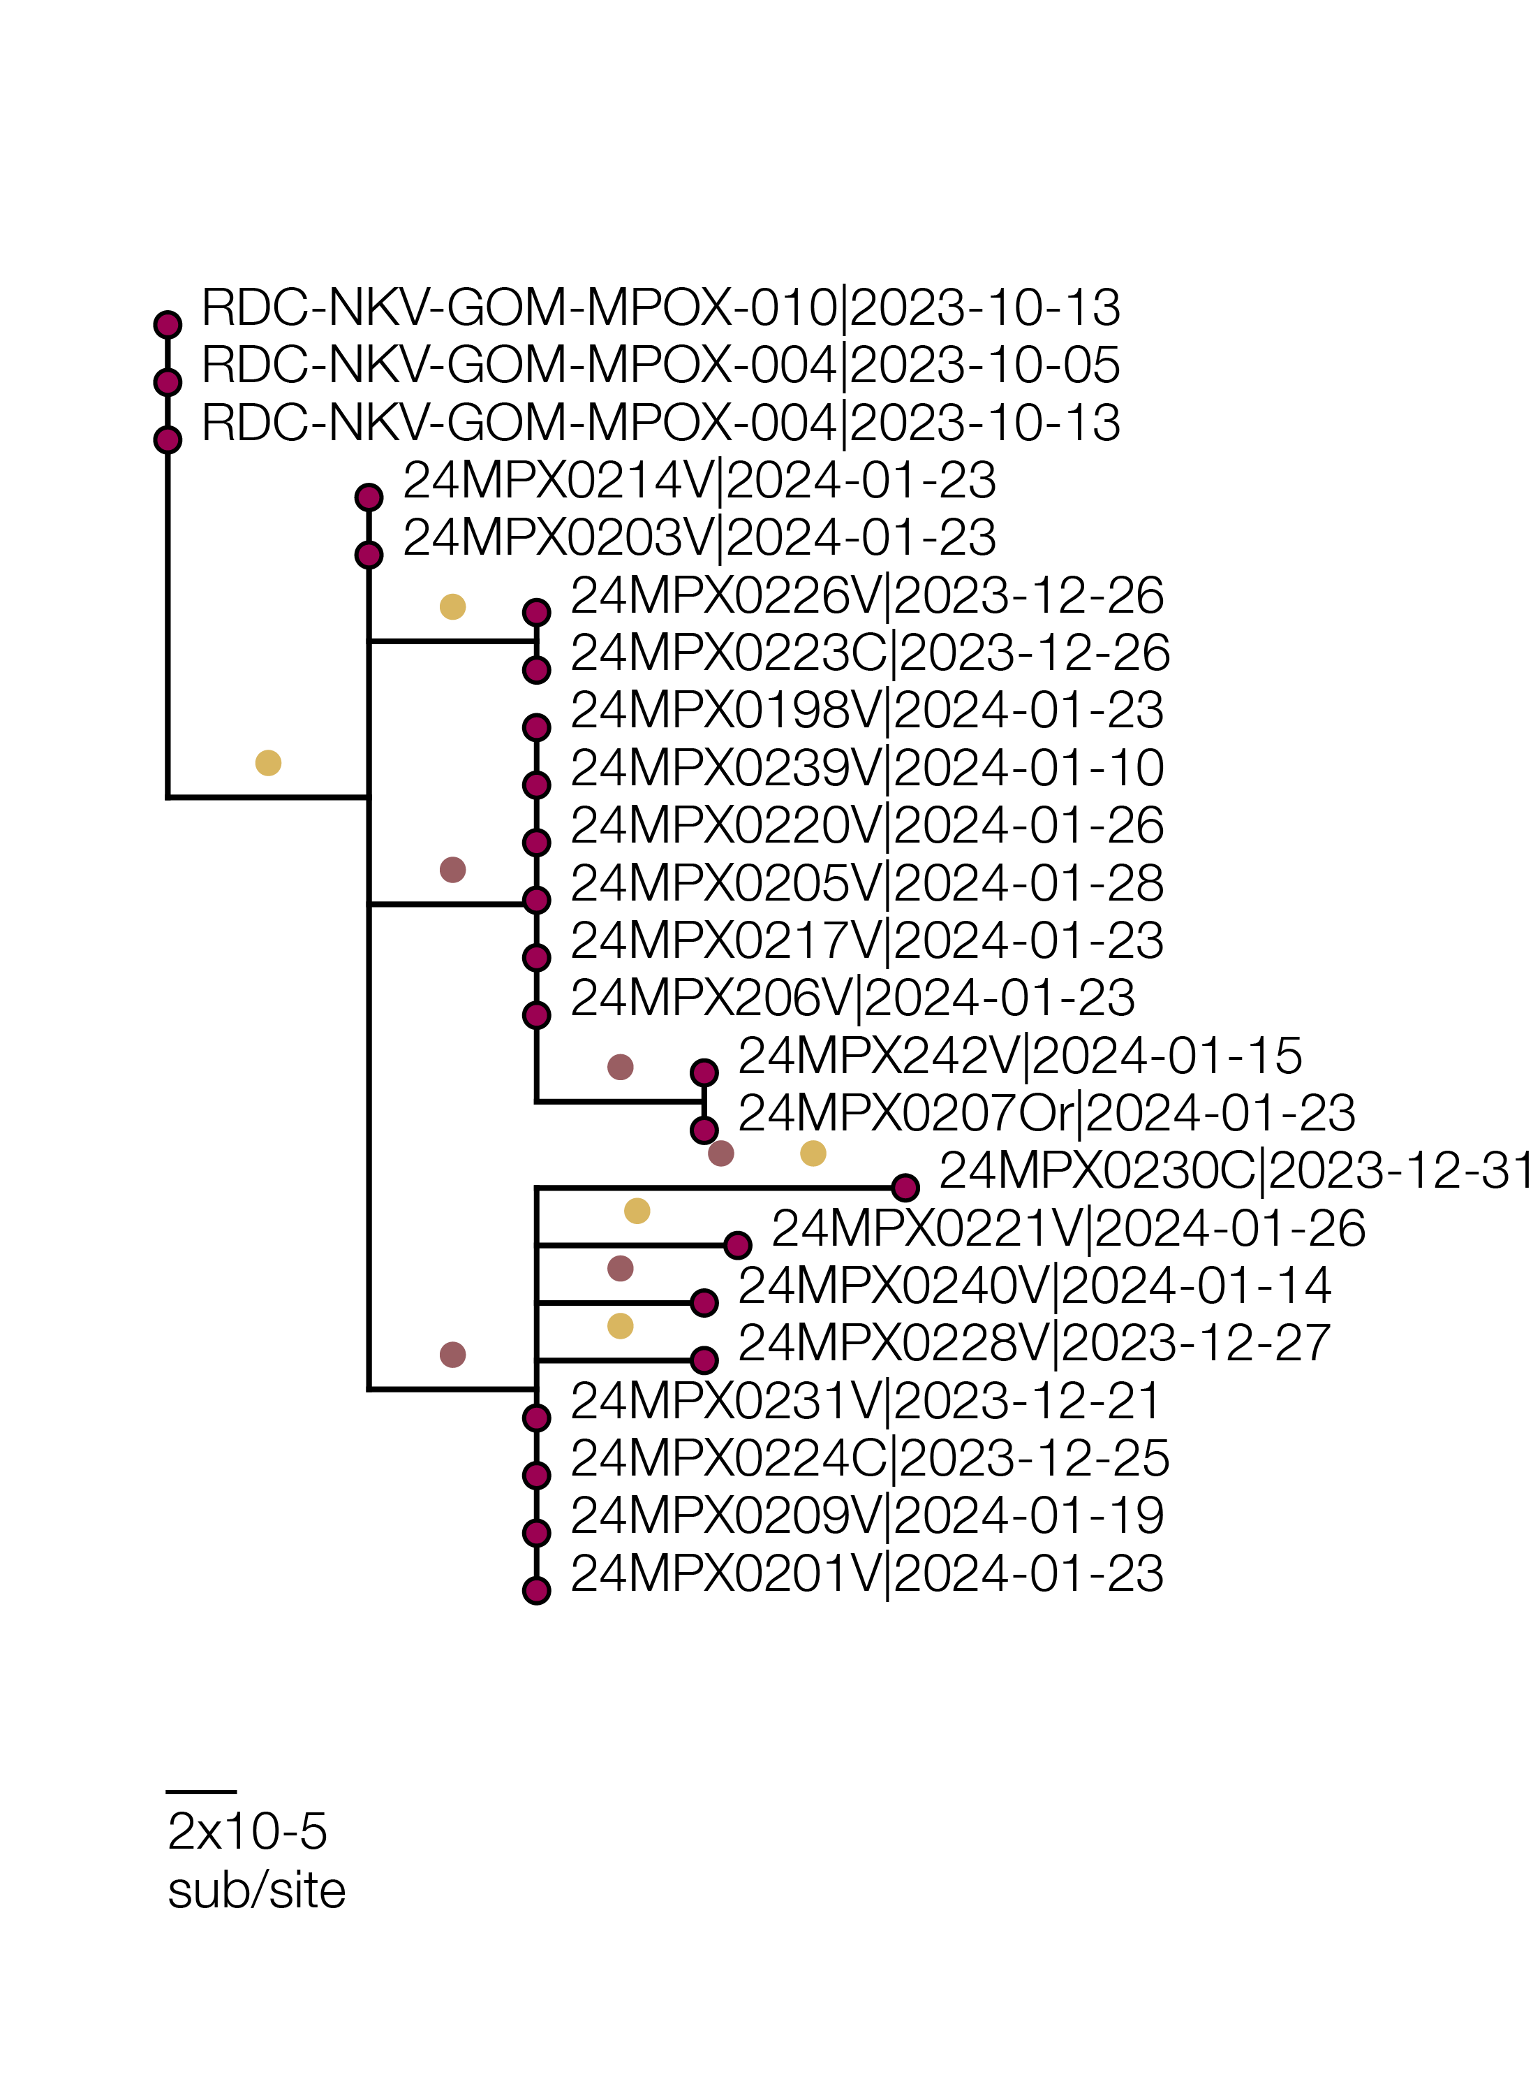
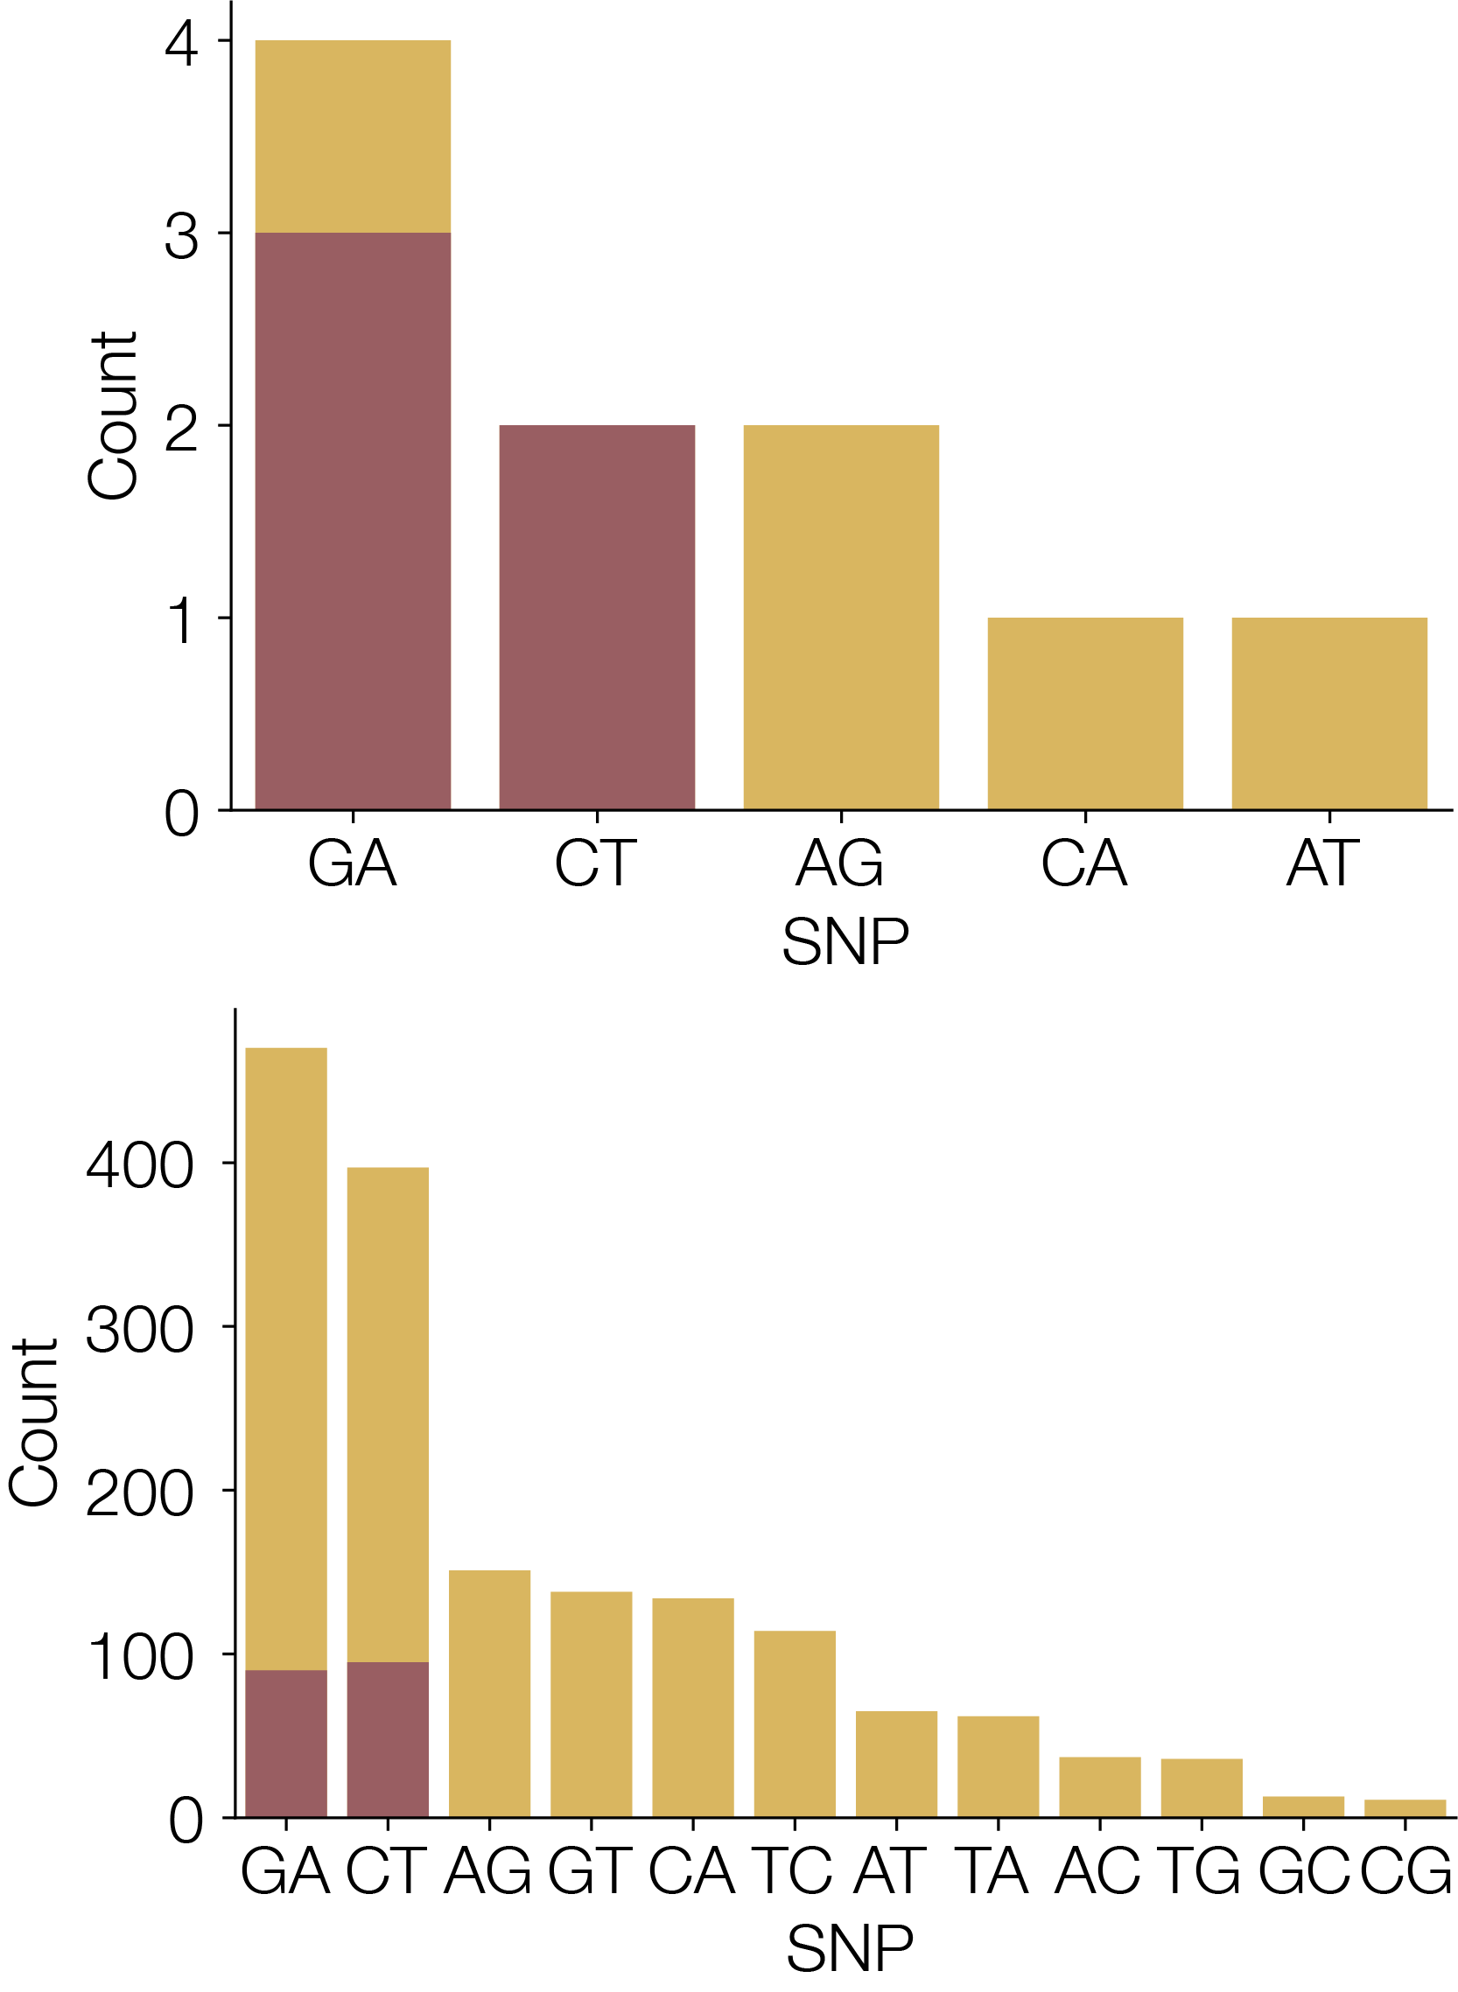
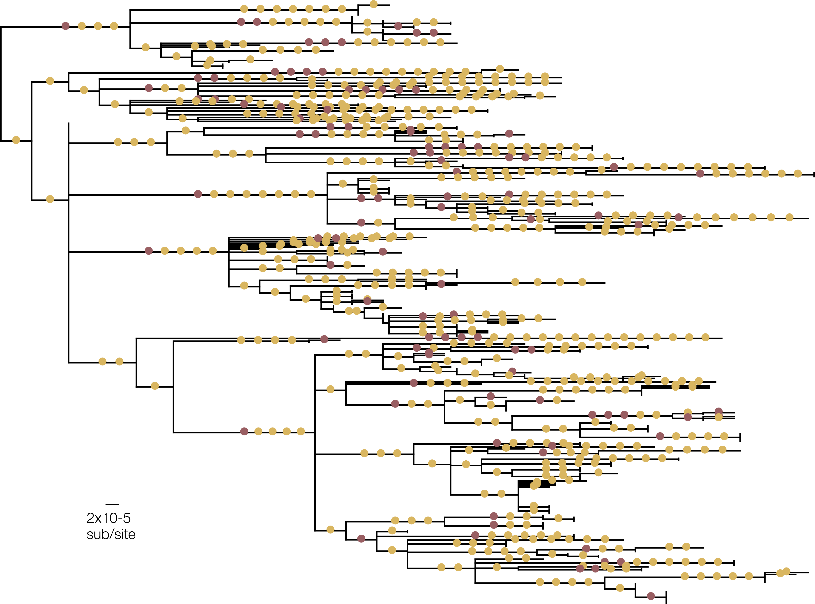
APOBEC3
Other
Sud-Kivu
50%
Other
11%
Slide from Áine O’Toole
Notes:
We see an enrichment of apobec3 in the south kivu province, with 50% of snps observed in south kivu consistent with apobec3 editing, and only 11% in the rest of the country
The numbers of snps in south kivu are small however

Slide 23
APOBEC3
Other
Sud-Kivu
Other
Probability of drawing 5 APOBEC3-like mutations from 10, under normal mutational process is 0.0005
Slide from Áine O’Toole
Notes:
but it is a statistically significant observation- of the 10 mutations, the probability of seeing 5 apobec-edits is very low under normal mutational processes

Slide 24
2023-4 DRC reported cases
Slide from Áine O’Toole
Notes:
So the DRC outbreak shows both forms of transmission- both the sustained human transmission, and also sporadic novel zoonotic events

Slide 25
MPXV phylogenetics is challenging
Large (~200kb)
Low complexity & repeat regions
Homopolymeric runs
Structural variation (large >1kb deletions)
Slide from Áine O’Toole

Slide 26
MPXV phylogenetics is challenging
Steps:
Alignment
Masking
Estimate a tree
Interpretation
Slide from Áine O’Toole

Slide 27
MPXV phylogenetics is challenging
Steps:
Alignment
Masking
Estimate a tree
Interpretation
Slide from Áine O’Toole

Slide 28
The mutations in a sequence alignment matter
Slide from Áine O’Toole

Slide 29
MPXV phylogenetics is challenging
Steps:
Alignment
Masking
Estimate a tree
APOBEC3 calculation
Interpretation
Slide from Áine O’Toole

Slide 30
Squirrel can help do these steps for you
Steps:
Alignment
Masking
Estimate a tree
APOBEC3 calculation
Interpretation
Slide from Áine O’Toole

